Slide 1
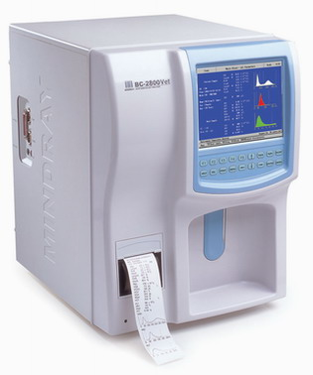
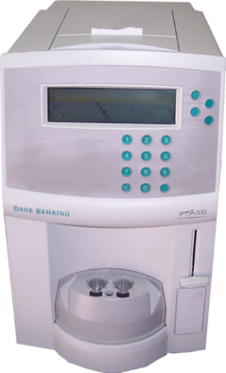
Hematology, Histology, Microbiology equipment
principles of operation
construction
troubleshooting
preventive maintenance theory
safety considerations
performance monitoring
18.7.11 Maintain an embedding centre, stainer and microtome
18.7.10 Maintain a tissue processor
18.7.9 Maintain a microbiology analyser
18.7.5 Maintain a platelet aggregation analyser
18.7.3 Maintain a haematology analyser
Unit C18.7 Maintaining Laboratory Equipment
Module 279 19 C Medical Instrumentation II
©
dr. Chris R. Mol, BME, NORTEC, 2016

Slide 2
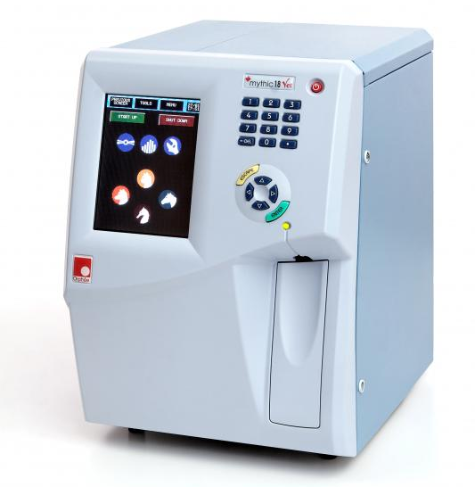
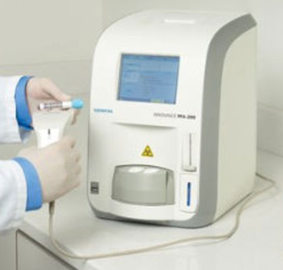
Hematology: equipment
hematology analyser
platelet aggregation analyser
NB: Hematology is restricted to blood cell and blood clotting (coagulation) measurements;
other blood chemicals are part of biochemistry lab, e.g. blood gas analyzers.
©
Hematology, Histology, Microbiology
dr. Chris R. Mol, BME, NORTEC, 2016

Slide 3
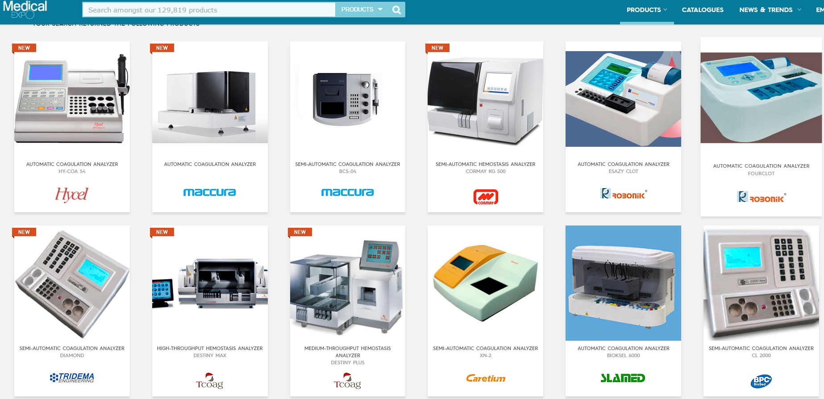
a huge variation in (coagulation) analysers on the market
©
Hematology, Histology, Microbiology
dr. Chris R. Mol, BME, NORTEC, 2016

Slide 4
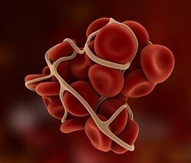
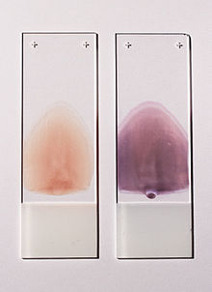
Hematology
Hematology analyzers are used widely to count and characterize blood cells for disease detection and monitoring. Basic analyzers return a complete blood count (CBC), a count of the total number of red blood cells, white blood cells and platelets present in the blood. The main technology used in hematology analyzers is electrical impedance, also known as the Coulter Principle: see next page.
Coagulometers (such as platelet aggregation analyzers) measure the ability of blood to clot. Depending on the test, different substances can be added to the blood plasma to trigger a clotting reaction. The progress of clotting can be monitored optically by measuring the absorbance of a particular wavelength of light by the sample and how it changes over time.
clotted blood cells
Blood can also be studied with a microscope: in a blood film, blood is smeared over a glass slide that is stained with specific dyes. The number, shape and size of blood cells and the presence of any abnormal cells or immature cells are noted.
Right hand side blood smear is stained.
©
Hematology, Histology, Microbiology
dr. Chris R. Mol, BME, NORTEC, 2016

Slide 5
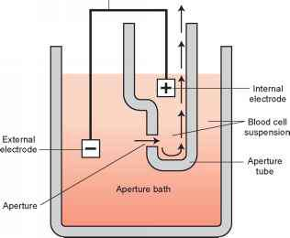
Electrical Impedance analysis
A DC voltage is applied between electrodes that are inserted in a electrolyte solution that contains blood cells (‘whole blood’). This voltage will cause a flow through the aperture (opening): see figure. The aperture is so narrow that only one cell can pass through at a time.
The impedance that is measured between the electrodes changes every time that a cell passes through the aperture. In this way, the number of cells that pass through can be counted.
The change in impedance that is measured when the cell passes through is proportional to the volume of the cell that is passing through the aperture. Therefore, this system can not only count the number of cells but also the volume of the cells that pass through. Because the different blood cells have different volumes, a Complete Blood Count can be made.
The Coulter Principle
Counting rates of up to 10,000 cells per second can be achieved and a typical impedance analysis can be carried out in less than a minute.
©
Hematology, Histology, Microbiology
dr. Chris R. Mol, BME, NORTEC, 2016

Slide 6
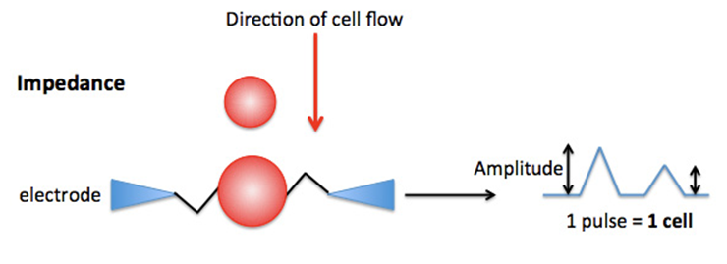
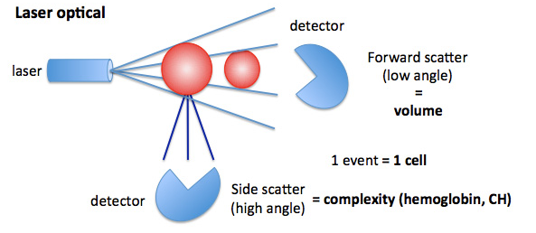
Haematology analysers
Automated cell counters sample the blood, and quantify, classify, and describe cell populations (complete blood counts, etc.).
Impedance analysis involves passing a dilute solution of the blood through an aperture across which an electrical current is flowing. The passage of cells through the current changes the impedance between the terminals (the Coulter principle).
Optical detection is more expensive than impedance analysis, but can distinguish between different cell shapes. A dilute suspension of cells is passed through a flow cell, which passes cells one at a time through a capillary tube past a laser beam. The reflectance, transmission and scattering of light from each cell is analysed by sophisticated software. This results in information on the cell’s granularity, diameter, and inner complexity. Adding fluorescent reagents helps to measure specific cell populations.
©
Hematology, Histology, Microbiology
dr. Chris R. Mol, BME, NORTEC, 2016

Slide 7
Platelet aggregation analysers
Platelet Aggregation Analyzers (Aggregometers) are used for platelet function testing. This test aids in the evaluation of bleeding disorders by measuring the rate and degree to which platelets form a clump (aggregate) after the addition of a chemical that stimulates clumping (aggregation).
Platelet aggregometers use optical, electrical-impedance, bioluminescence, or particle-counting detection methods.
Optical platelet aggregation meters are colorimeters used to gauge ‘cloudiness of the fluid’ by measuring the decrease in optical density (OD) when the platelet aggregation decreases.
The measurement is performed after the addition of an aggregating agent which causes aggregated platelets to go from translucency to color.
©
Hematology, Histology, Microbiology
dr. Chris R. Mol, BME, NORTEC, 2016

Slide 8
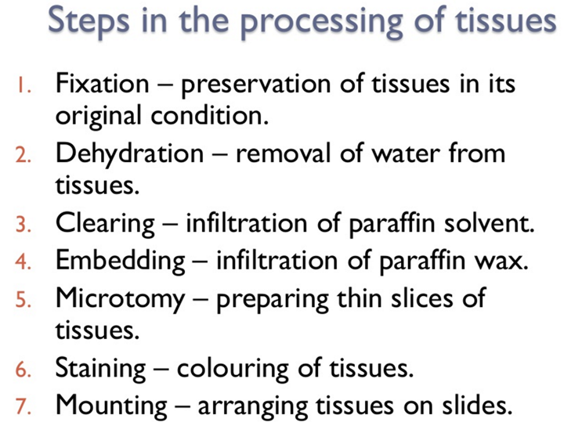
Histology: Tissue Processing
Tissue samples, when taken from a patient and left untreated, may degrade quickly and cannot easily be cut in slices to be viewed under the microscope. In order to stabilize the tissues, these need to be ‘fixed’ by means of various chemical processes, while preserving the integrity of their cellular components.
The aim of Tissue Processing is to remove water from tissues and replace with a medium that solidifies to allow thin sections to be cut, typically 5 micrometres thick for light microscopy. Paraffin wax is most frequently used. Since it cannot be mixed with water, water must first be removed in the process of dehydration.
Samples are transferred through baths of progressively more concentrated ethanol to remove the water. This is followed by a hydrophobic clearing agent (such as xylene) to remove the alcohol, and finally molten paraffin wax, the infiltration agent, which replaces the xylene.
This now is solid enough to be cut in the required sections.
©
Hematology, Histology, Microbiology
dr. Chris R. Mol, BME, NORTEC, 2016

Slide 9
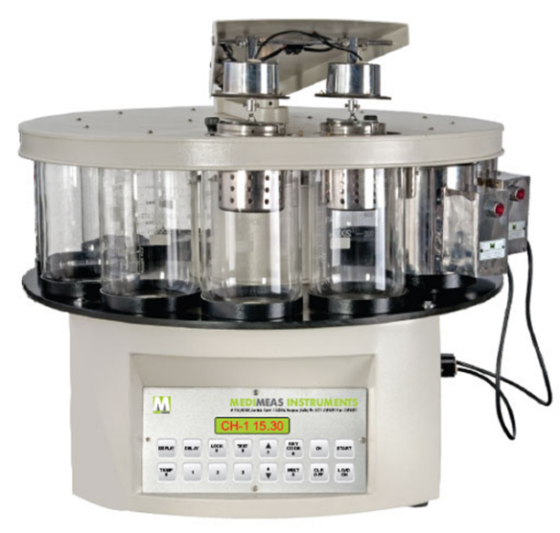
Tissue Processor
Tissue processors automate the fixation, dehydration and clearing activities.
In moving basket processors, reagents are held in (glass, plastic) beakers that are (e.g.) located in a circular array beneath a carriage supported by a central master shaft.
Tissues are placed in individual perforated cassettes, each of which is placed in a larger perforated tissue basket, which is then attached to the carriage. The carriage moves the basket to each reagent, which enters the basket. The system is motor driven and timer controlled.
Stationary chamber processors alternately fill and drain the chamber holding specimens with fixative, dehydrating agents, clearing agents, and embedding fluids as required. Small pumps add and withdraw fluid to and from the chamber; some units use a vacuum to fill the chamber and pressure to drain the chamber and fluid lines.
©
Hematology, Histology, Microbiology
dr. Chris R. Mol, BME, NORTEC, 2016

Slide 10
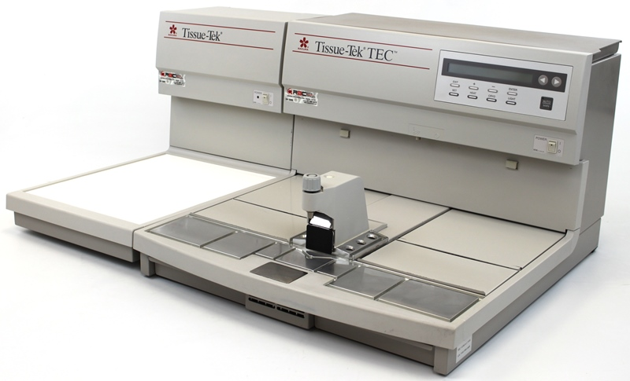
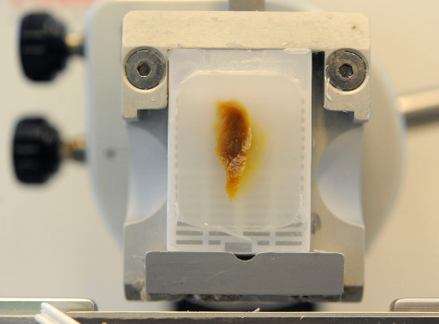
Tissue Embedding Station
During embedding the tissue samples are placed into moulds along with liquid embedding material (such as agar, gelatine, or wax) which is then hardened. This is achieved by cooling in the case of paraffin wax and heating (curing) in the case of the epoxy resins. The hardened blocks containing the tissue samples are then ready to be sectioned.
Heart tissue sample embedded in wax, ready to be cut in slices
Embedding can also be accomplished using frozen, non-fixed tissue in a water-based medium. Pre-frozen tissues are placed into moulds with the liquid embedding material, usually a water-based glycol which is then frozen to form hardened blocks.
©
Hematology, Histology, Microbiology
dr. Chris R. Mol, BME, NORTEC, 2016

Slide 11
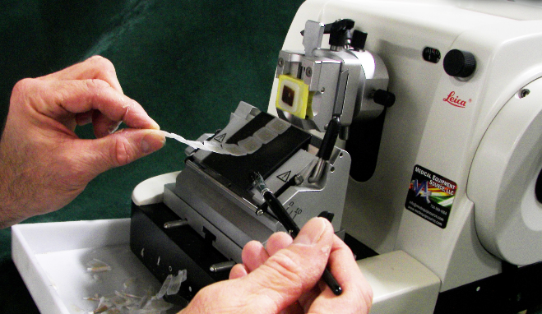
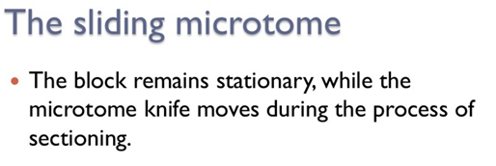
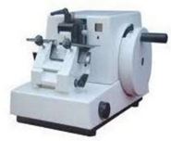
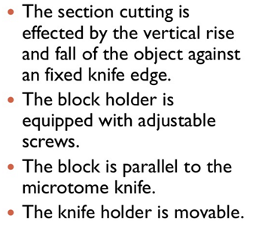
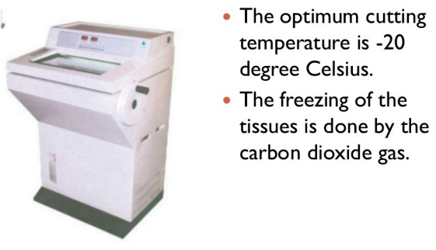
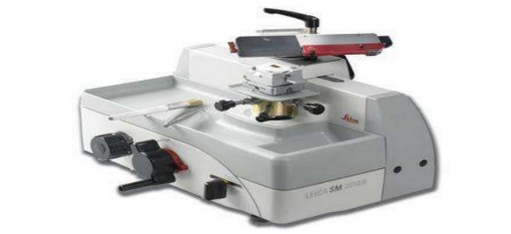
Microtome
A microtome is a tool used to cut extremely thin slices of material, known as sections. Microtomes use steel, glass, or diamond blades depending upon the specimen being sliced and the desired thickness of the sections being cut. Microtome sections can be made thin enough to section a human hair across its breadth, with section thickness between 50 nm and 100 µm.
©
Hematology, Histology, Microbiology
dr. Chris R. Mol, BME, NORTEC, 2016

Slide 12
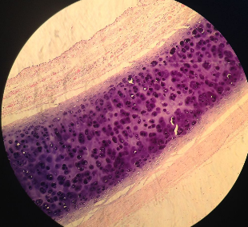
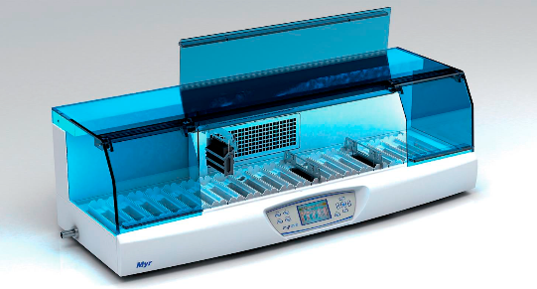
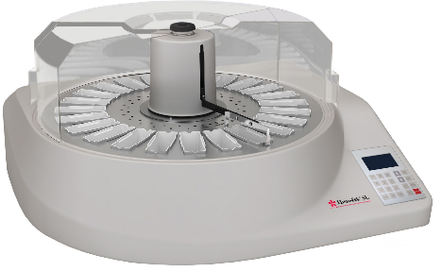
Stainer
Staining is a supporting technique used in microscopy to enhance contrast and highlight structures a microscopic image of a biological tissue.
Automated Slide stainers are devices that automate this process. These are microprocessor controlled.
Linear transport slide stainers
The operator inserts slides into a carrier and selects a time or programmed procedure.
Linear transport slide stainers have a transport arm that moves baskets of slides into and out of parallel regent vessels.
Centrifugal stainers spray reagents onto slides placed in a rotating carousel and uses centrifugal force to remove excess reagents and dry the slides.
Centrifugal slide stainers
©
Hematology, Histology, Microbiology
dr. Chris R. Mol, BME, NORTEC, 2016

Slide 13
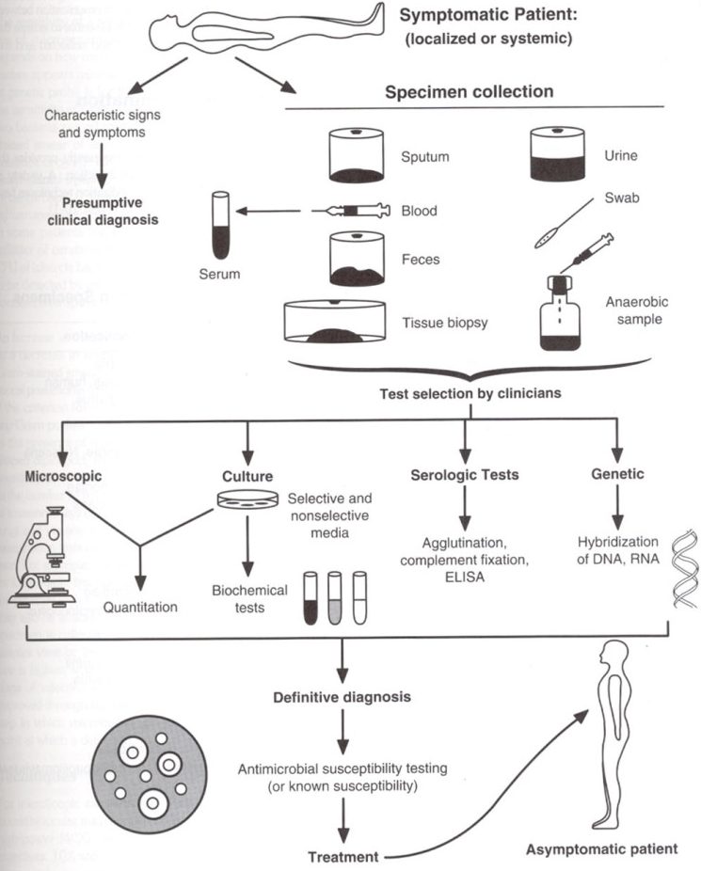
Microbiology
Some infectious diseases are distinctive enough to be identified from their clinical symptoms (patient complaints).
Most microbes, however, can cause a wide spectrum of clinical symptoms. Conversely, a single clinical syndrome may result from infection with any one of many microbes. You need to know which microbe caused the symptoms in order to know how to treat it.
Often, therefore, it is necessary to use microbiologic laboratory methods to identify the pathogen.
The job of the clinical microbiology laboratory is to test specimens from patients for microorganisms that are, or may be, a cause of the illness and to provide information about the effectivity of certain antimicrobial drugs against these microorganisms identified.
©
Medical Laboratory
dr. Chris R. Mol, BME, NORTEC, 2016

Slide 14
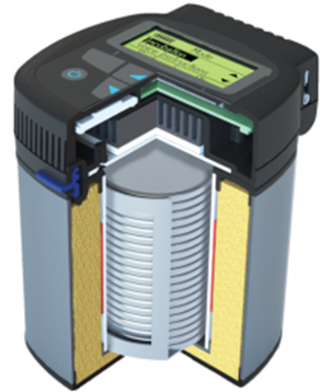
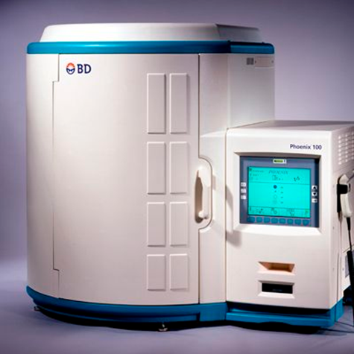
Microbiology Analyser
Historically, there is not much automation in microbiology laboratories. But with increasing testing, shortage in technologists and more financial pressures, this now starts to take off.
Clinical microbiology consists of a wide array of techniques for the detection of infectious diseases.
  The respiratory diseases segment is the largest application segment of the clinical microbiology market, including e.g.
  The outbreak of new diseases such as Ebola is expected to increase the disease burden and the demand for clinical microbiology products.
The microbiology instruments market is segmented into
  automated microbiology instruments,
  laboratory instruments, including petri-dish fillers, sterilizers, bacterial colony counters, etc.
  microbiology analyzers, including spectrometers to analyze which bacteria are present on a petri dish.
©
Hematology, Histology, Microbiology
dr. Chris R. Mol, BME, NORTEC, 2016

Slide 15

END
The creation of this presentation was supported by a grant from THET:
see https://www.thet.org/

